Slide 1
IBM University Engagement Project Submission
“Exploring the Power of Agentic AI with IBM Granite and LangFlow”

Slide 2

Project Tile – Interview Trainer Agent
Domain of Project – EdTech / HR Tech
Student Name | Recent Passport Photo | Email ID | Mobile number [WhatsApp]
Aryan Sharma |  | aryansh102005@gmail.com | 9354673723

Slide 3
Problem Statement -Interview Trainer Agent
The Challenge –
An Interview Trainer Agent, powered by RAG (Retrieval-Augmented Generation), prepares users for job interviews by generating tailored question sets and preparation strategies based on their profile name, experience level, and job role. It retrieves role-specific interview questions, industry expectations, behavioral scenarios, and HR guidelines from recruitment portals, professional networks, and company interview databases. Users can input their resume or job title, and the agent provides targeted questions, model answers, and improvement tips. It supports both technical and soft skill assessment, ensuring a comprehensive interview prep experience. This AI-driven assistant builds user confidence, sharpens responses, and increases success rates in competitive hiring environments.

Slide 4
Proposed Solution -
An AI-powered Interview Trainer Agent built using IBM watsonx.ai, IBM Granite Models, FastAPI, and Streamlit to provide personalized, real-time interview preparation. The system addresses the challenges of generic preparation material, lack of actionable feedback, and absence of role-specific guidance through an intelligent, modular architecture.
At its core, a RAG pipeline (ChromaDB + sentence-transformers) retrieves role-specific content from a curated knowledge base of 54 documents — covering technical question banks, behavioral scenarios, HR guidelines, and experience-level expectations — before IBM Granite generates a grounded response.
Two core agents power the system:
Resume Analyzer Agent — parses PDF, DOCX, or TXT resumes to extract skills and experience for session personalization.
Interview Trainer Agent — retrieves context from ChromaDB and sends structured prompts to IBM Granite for question generation, answer evaluation, model answers, and strategy building.
Key Features:
Tailored questions across 10 job roles and 6 experience levels (Fresher to Principal)
AI answer evaluation with feedback on accuracy, clarity, and completeness
30-day personalised preparation roadmap with HR guidelines and salary negotiation tips
HR Interview Guide with dos, don'ts, and virtual interview best practices

Slide 5
Technology Used
IBM Granite Model (ibm/granite-3-1-8b-base) — For natural language understanding, question generation, answer evaluation, and personalized preparation strategies via IBM watsonx.ai.
IBM watsonx.ai — For Granite model deployment, API-based inference, and AI governance with controlled generation parameters.
IBM Cloud (Lite Tier) — Provides the infrastructure to authenticate and consume IBM watsonx.ai services with API key-based access management.
RAG (Retrieval-Augmented Generation) — Retrieves role-specific context from the knowledge base before IBM Granite generates responses, ensuring grounded and accurate output.
ChromaDB — Persistent local vector store containing 54 embedded documents (technical Q&As, behavioral questions, HR guidelines) enabling fast cosine-similarity semantic search for RAG retrieval.
Sentence Transformers (all-MiniLM-L6-v2) — Generates text embeddings for indexing and retrieving documents from ChromaDB.
FastAPI — REST API backend with 15 endpoints covering session management, question generation, answer evaluation, and preparation strategy.
Streamlit — Interactive multi-page frontend with IBM Carbon Design styling for session creation, question practice, and preparation roadmap access.
PyPDF / python-docx — Parses uploaded PDF, DOCX, and TXT resumes to extract skills.

Slide 6
Component Used -
1) Chat Input (Streamlit Text Areas) User-facing input fields in the Streamlit UI where candidates enter their name, job role, resume text, interview questions, and answers for evaluation.
2) IBM watsonx.ai Agent The Interview Trainer Agent connects to IBM watsonx.ai using the ibm-watsonx-ai Python SDK, invoking IBM Granite to process structured prompts and generate personalized interview responses.
3) IBM Granite Model ibm/granite-3-1-8b-base — Used for question generation, answer evaluation, model answer creation, and preparation strategy building.
4) Chat Output (Streamlit Rendered Responses) AI-generated responses — including questions, evaluation feedback, model answers, and preparation roadmaps — are displayed in styled output panels in the Streamlit interface.
5) File Component (Resume Upload) The st.file_uploader component in Streamlit accepts PDF, DOCX, and TXT resume files, which are parsed by PyPDF and python-docx to extract skills, experience, and profile data.
6) Vector Store Component (ChromaDB) Stores and retrieves 54 embedded interview knowledge documents using cosine-similarity semantic search to supply relevant context to IBM Granite before generation.

Slide 7
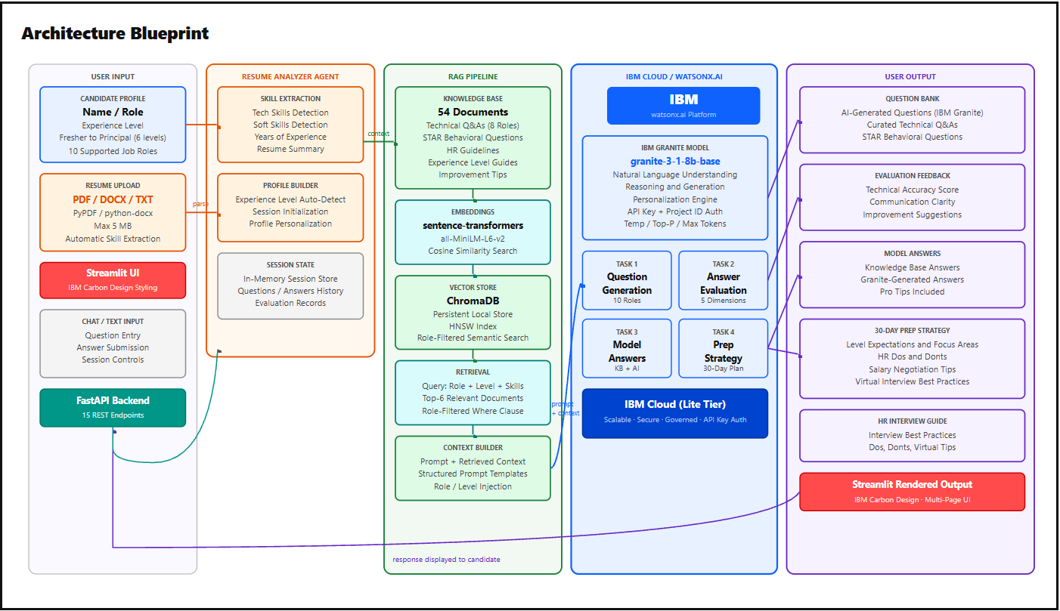
Architecture blueprint

Slide 8

Role of Agentic AI in the solution
Agentic AI enables the Interview Trainer Agent to function as an intelligent, autonomous system rather than a simple Q&A chatbot. Using IBM watsonx.ai and IBM Granite models, it coordinates multiple specialized agents to deliver personalized, end-to-end interview preparation.
The Resume Analyzer Agent parses uploaded resumes (PDF, DOCX, TXT) to extract technical skills, soft skills, and experience, while the Interview Trainer Agent orchestrates the full pipeline — retrieving role-specific context from ChromaDB and generating tailored questions, evaluations, model answers, and preparation strategies — all within a single session.
Rather than relying on model memory alone, the RAG pipeline first retrieves semantically relevant knowledge from a curated vector store of 54 documents before passing context to IBM Granite — ensuring grounded, accurate results.
The system maintains context awareness and session-based adaptation, tracking candidate state, evaluated answers, and session history so every response builds on what the candidate has already practiced — across 10 job roles and 6 experience levels from Fresher to Principal.
Overall, Agentic AI makes the system proactive, personalized, and goal-driven — acting like a smart digital interview coach that builds confidence and increases success rates in competitive hiring environments.

Slide 9
Novelty and Uniqueness
Multi-Agent Intelligence — Two specialized agents collaborate: the Resume Analyzer extracts skills and experience, while the Interview Trainer Agent uses that profile to generate tailored questions, evaluate answers, and build preparation strategies.
RAG-Based Accuracy — Semantic retrieval from ChromaDB vector store grounds every IBM Granite response in verified knowledge from a 54-document curated knowledge base, reducing hallucination.
Hyper-Personalization — Questions, difficulty, model answers, and roadmaps are tailored to job role, experience level (Fresher to Principal), and resume-detected skills — no two sessions are identical.
Resume-Driven Sessions — Supports PDF, DOCX, and TXT resume uploads with automatic skill extraction to personalize the session instantly.
Comprehensive Coverage — Technical questions, STAR behavioral questions, model answers, 30-day prep roadmap, HR guidelines, and salary negotiation — all in one platform.
Scalable and Enterprise-Ready — Built on IBM watsonx.ai with IBM Granite models and IBM Cloud Lite, ensuring governed, reliable AI deployment.

Slide 10
Git Hub Link
Github URL – https://github.com/Ark004-gif/Interview-Trainer-Agent
·
·
·

Slide 11
Future Scope
The Interview Trainer Agent can be significantly enhanced in the following directions:
Voice-Based Interview Simulation — Integrate speech-to-text and text-to-speech capabilities to simulate real verbal interview conditions, allowing candidates to practice spoken responses and receive pronunciation and pacing feedback.
Live Scoring Dashboard — Add a visual analytics panel showing session-wise scores, skill-wise performance across technical, communication, and problem-solving areas, and overall interview readiness trends over time.
Expanded Knowledge Base — Continuously grow the vector store with company-specific interview questions, domain-specific technical assessments, and real interview experiences sourced from professional networks.
Multi-Language Support — Leverage IBM Granite's multilingual capabilities to support interview preparation in regional languages, broadening accessibility for non-English-speaking candidates.
LangFlow Workflow Orchestration — Migrate the agent pipeline to LangFlow for visual, no-code orchestration of multi-agent workflows, enabling easier customization and deployment without code changes.
·
·
·

Slide 12
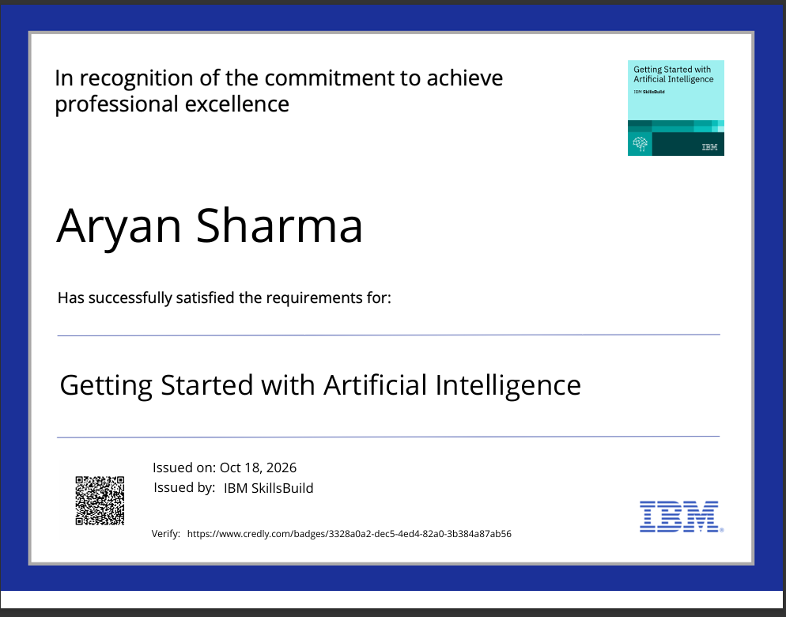
Certificates Earned:
Please add your credly certificate

Slide 13
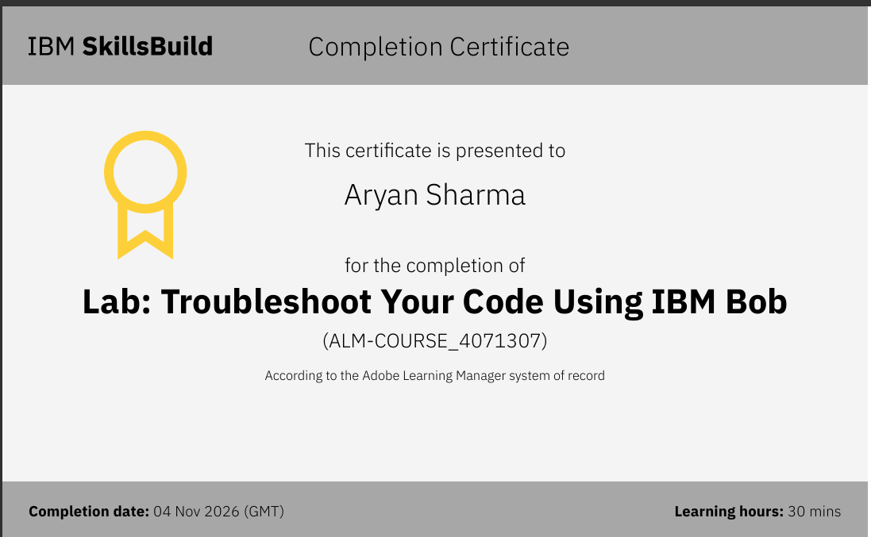
Certificates Earned:​
Add your IBM BOB Certificate

Slide 14


